Slide 1





Black Blaze
Name: Wei Wang
Student ID: 10446039
Department: CS
Level: PHD
Name: Chenxu Wang
Student ID: 10457625
Department: CS
Level: Graduate
Name: Huijun Sun
Student ID: 10457635
Department: CS
Level: Graduate
Name: Zhanming Bai
Student ID: 10457588
Department: CS
Level: Graduate
Course Section: Section B

Slide 2

IBM Company
Attribution Analysis
___________________________________________
CS 513
Knowledge Discovery & Data Mining

Slide 3

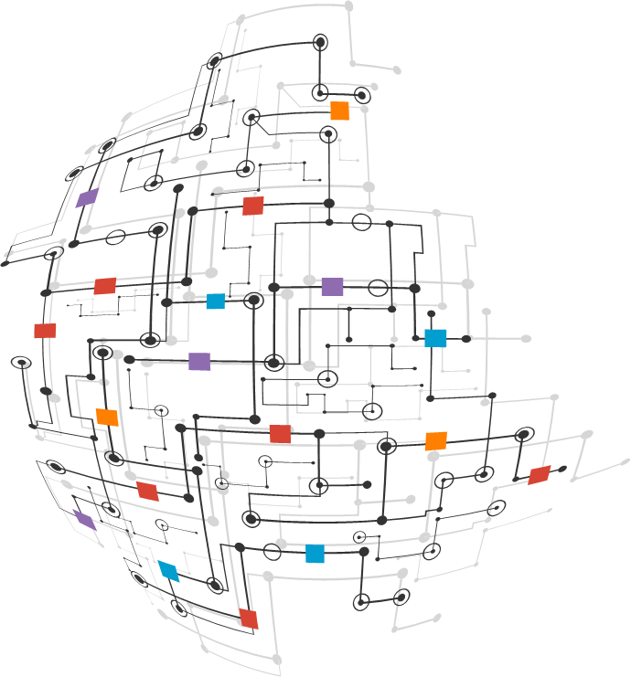
Introduction n
3
___________________________________________
IBM Company Attribution Analysis
We do some basic analysis of employee information From IBM. The data contains ANNUAL_RATE annual rate, haly rate, ethnicity, sex, marital status, job satisfaction, age, number of team changed, referral source,hire month, termination year, rehire. By analyzing the relationship amongst those, we can provide a model for the hiring management to better hire people and make best use of human resources.

Slide 4
Data Details n
4
___________________________________________
The dataset is from IBM, and the dataset contains 9612 IBM employees’ basic information.
We used this to data to see if we could build a classifier that could predict whether or not this employee would stay on IBM.
There are 27 columns. 21 of which are employee attributes, one column for ID name, and other columns are not considered this time.

Slide 5
5
Data Attributes Analyzed
___________________________________________
Attribute | Type | Attribute | Type | Attribute | Type
ANNUAL_RATE | number | HRLY_RATE | number | ETHNICITY | chr
SEX | chr | JOB_SATISFACTION | number | AGE | number
MARITAL_STATUS | chr | REFERRAL_SOURCE | chr | REFERRAL_SOURCE | chr
NUMBER_OF_TEAM_CHANGED | number | TERMINATION_YEAR | number | HIRE_MONTH | number
REHIRE | chr | EDUCATION_LEVEL | chr | TRAVELLED_REQUIRED | chr
PERFORMANCE_RATING | number | IS_FIRST_JOB | chr

Slide 6
Research Questions
6
___________________________________________
The Employee information has many different dimensions, we want to extract hints from these dimensions to help management to predict if this employee would stay or leave. We sought out to answer the following questions:
Are there specific relationships between those attributes?
Which methodology is the most accuracy one among those methodology?
Can we give someone recommendation of one employee who would leave ?

Slide 7

7
Method Applied
K-Nearest-Neighbor
Cart
C50
Random Forest
Artificial Neural network
H-Clustering & K-means
Support Vector Machine
_________________________________

Slide 8
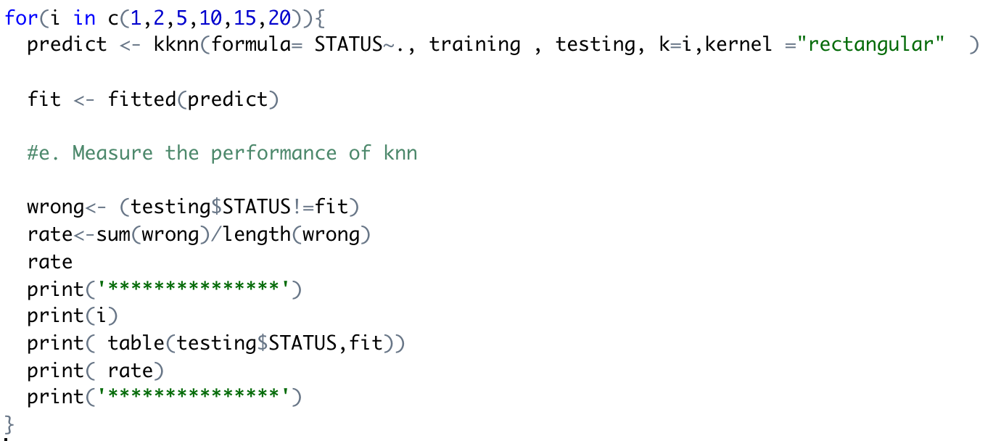
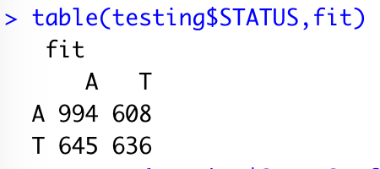
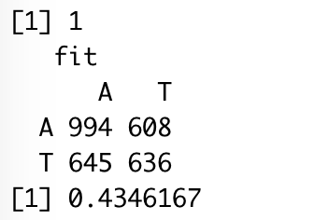
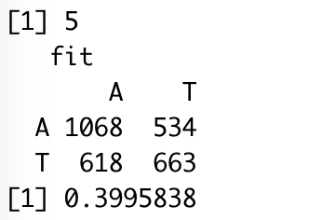
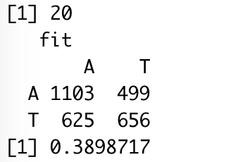
KNN
8
____________________
By using the KNN function, we can see that as the value of k increases, more and more people have similar working conditions and fewer people's work will be terminated.
Training the data by selecting K from 1 to 20

Slide 9
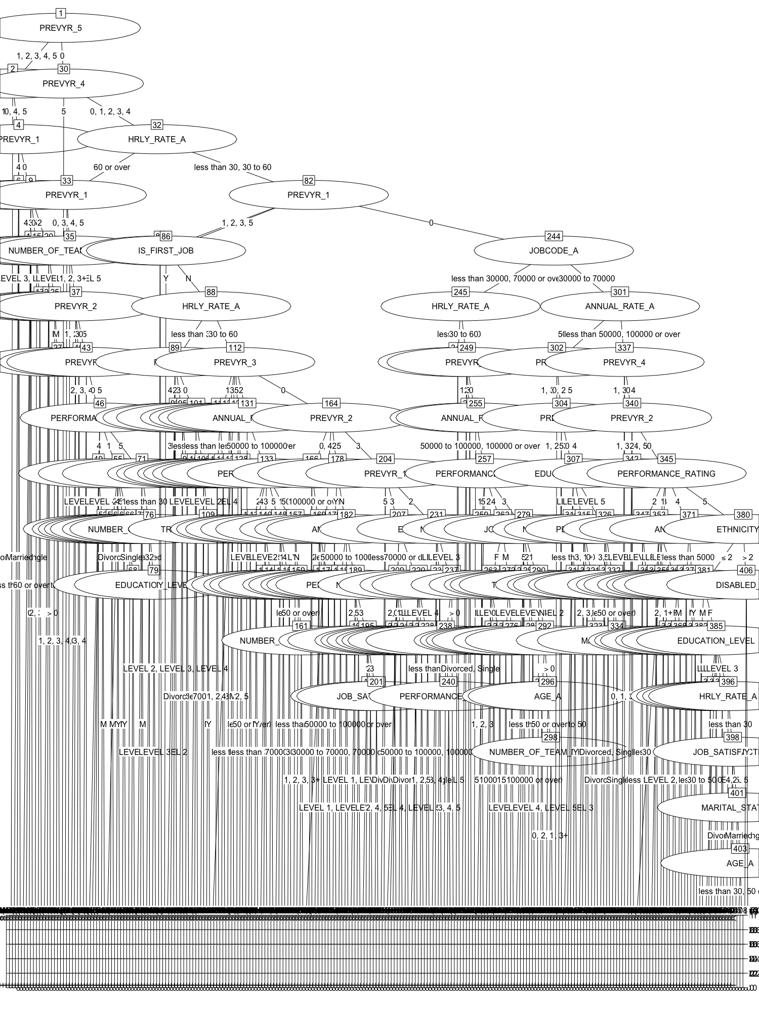
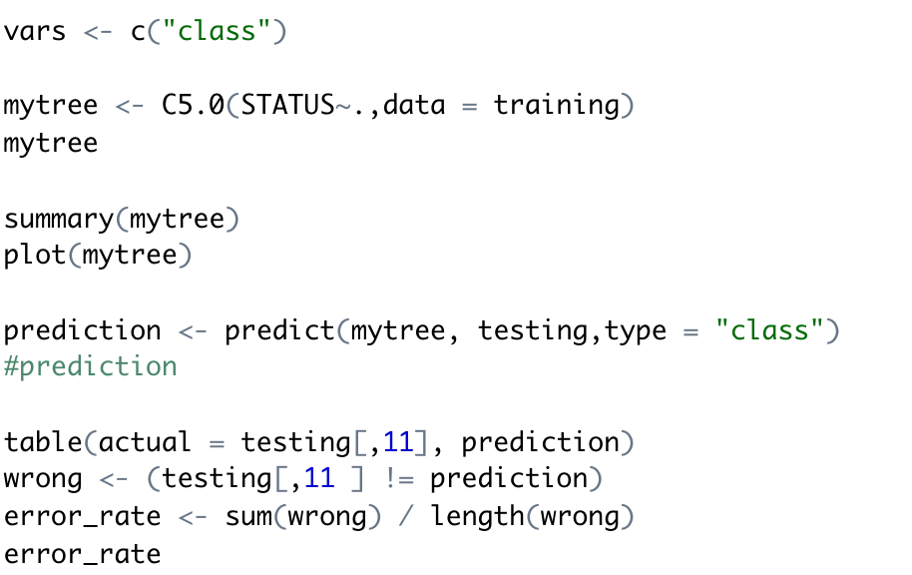
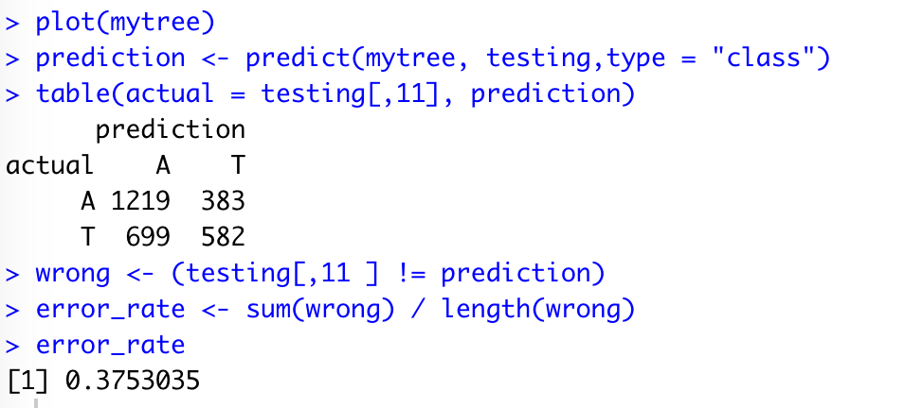
C50
9
____________________
C50
Tree
Plot

Slide 10
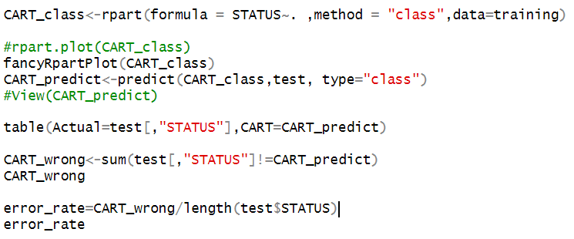
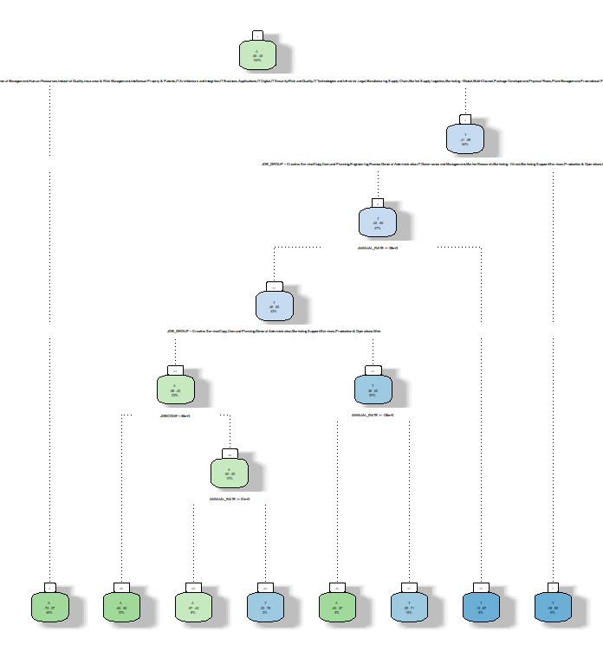
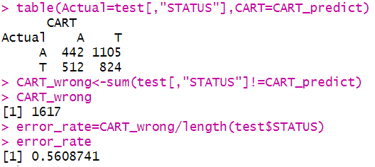
CART
10
____________________
Solution 1, using raw data and CART approach to classify leaves for predicting target dataset ‘STATUS’.

Slide 11
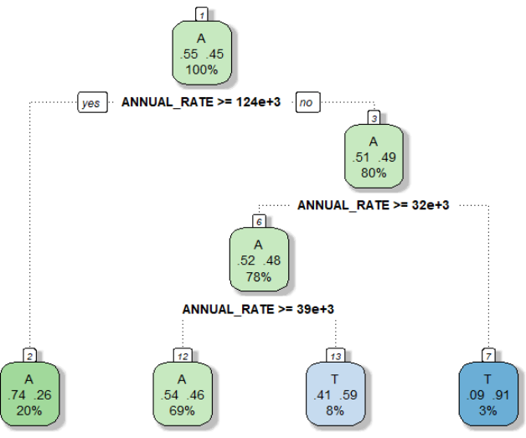
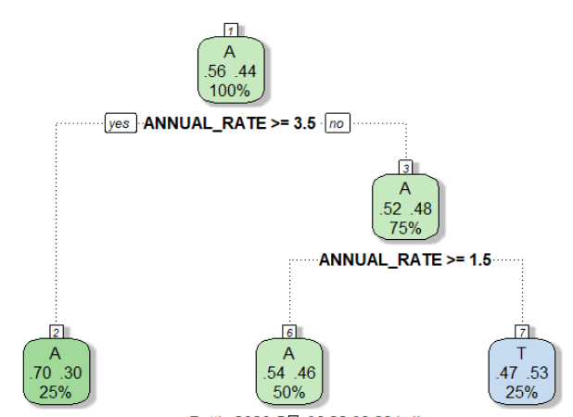
CART
11
____________________
With an approach called Classification And Regression Tree, we can classify groups of raw data to get connections between them and our target attributes.
For instance, we separated the raw data set of column ”Annual_Rate” to four groups by quantile its values as group.1 ”<50855.5&>16786.0”, group.2 “<74210.5& >50855.5”, group.3 “<108811.5&>74210.5”, and group 4”<1250924.0&>108811.5”. From the results, we can get that group.2 and group 3 are classified as be terminated, reversely, group.1 and group.4 are classified as not be terminated.
plot from CART solution 1
plot from CART solution 2

Slide 12
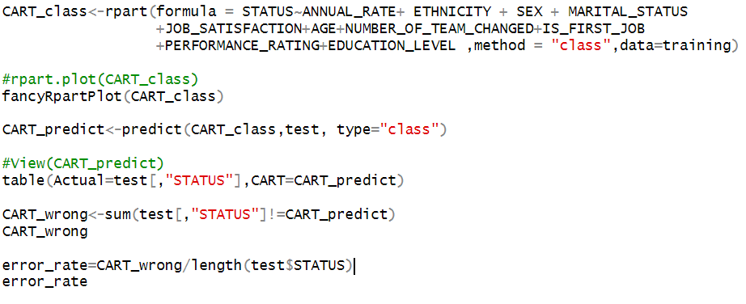
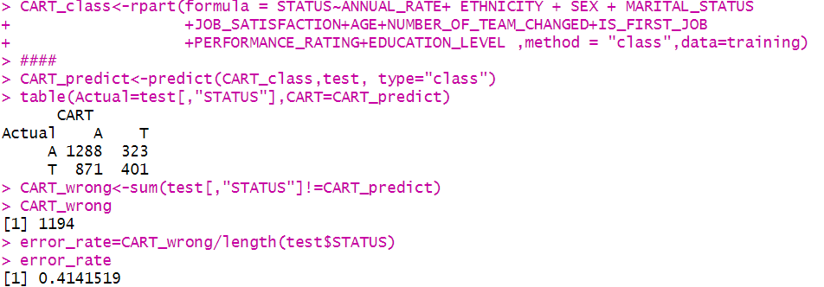
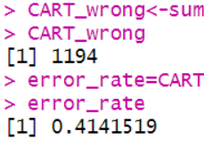
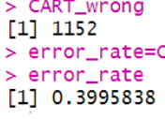
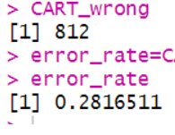
CART
12
____________________
Solution 2 with discrete datasets after operated.
By using CART approach, HRs could acquire more information for which part they need to focus on for deciding whether the employ should be terminated. It can improve effectives of both HR and company.

Slide 13
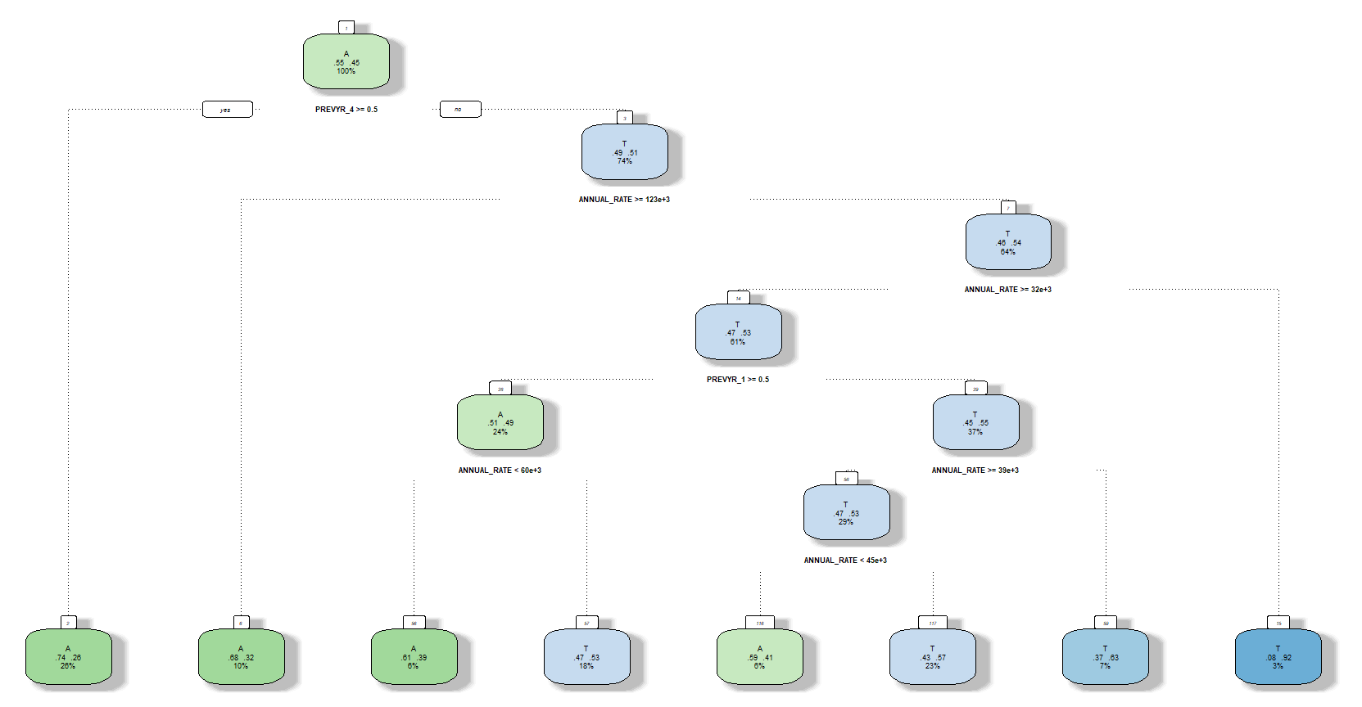
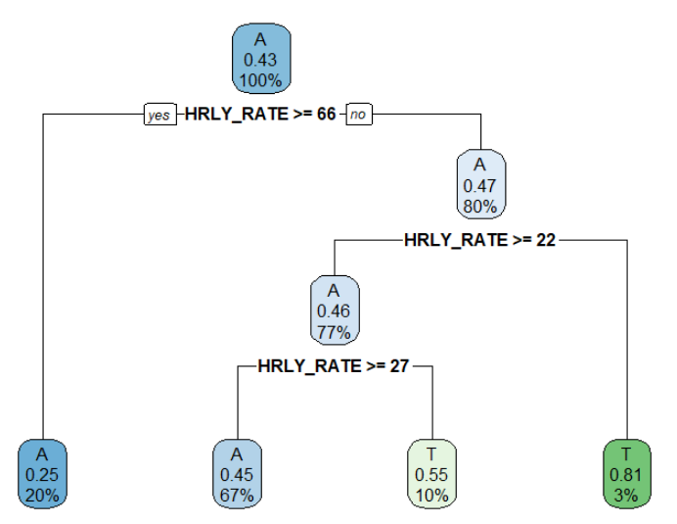
CART
13
____________________
By choosing different formula of CART approach, we could get different plot of outputs from it.
From the results, we could easily get the connections between values in datasets for training with the target dataset.

Slide 14
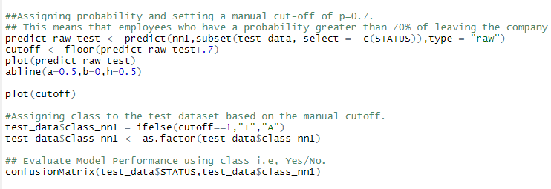
Artificial Neural Network
14
__________________________________________

Slide 15
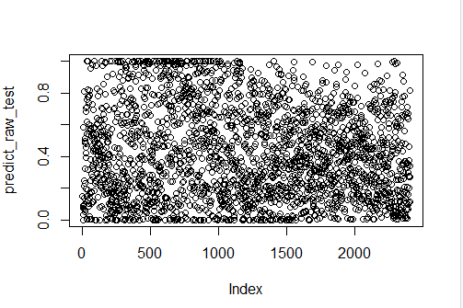
Artificial Neural Network
15
__________________________________________

Slide 16
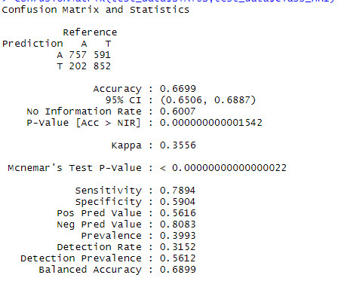
Artificial Neural Network
16
__________________________________________
Since our threshold of judgement that one employ would leave is 0.7, our prediction correct rate is 67% less than those with lower threshold. But it does make sense and can help HR save effort and time. Overall, it is beneficial for management to assign resources in a rational way.

Slide 17
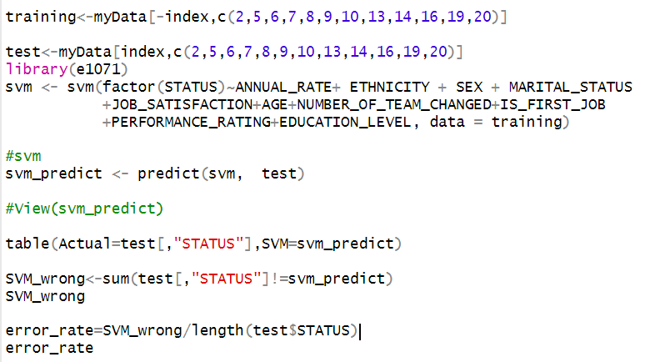
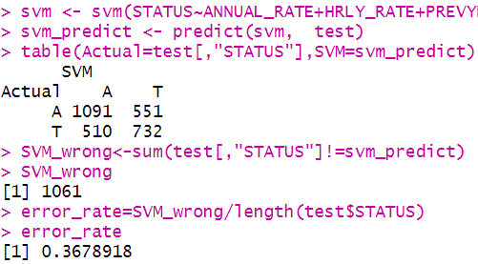
Support Vector Machine
17
__________________________________________

Slide 18
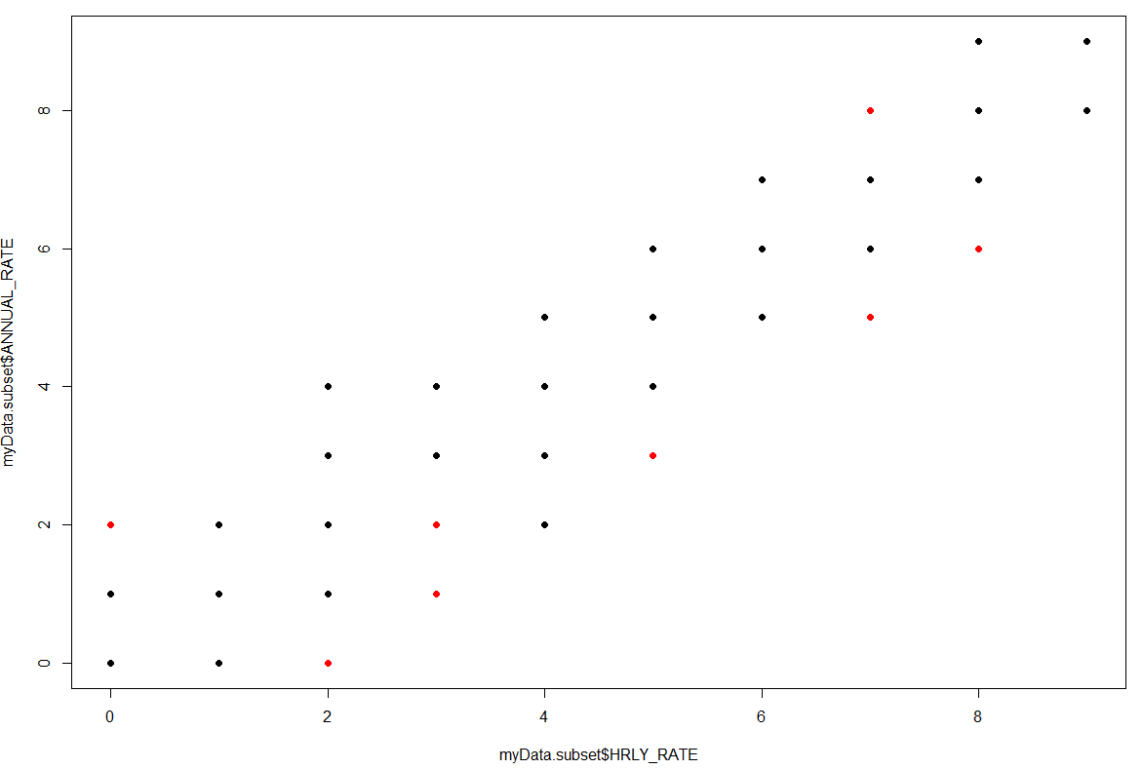
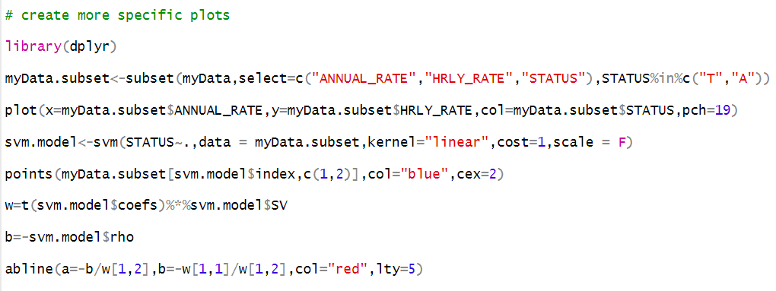
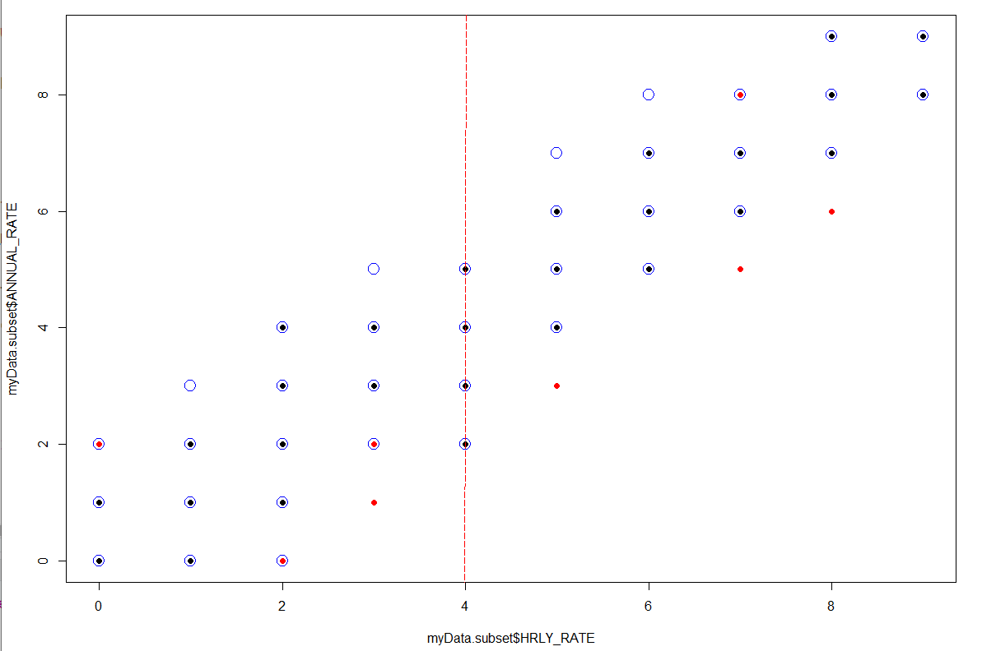
Support Vector Machine
18
__________________________________________
Graph-left is code for descripting plots
Graph-right-top is the Scatter Dataset Plot
Graph-right-bottom is right-top graph added support vector and dividing line

Slide 19
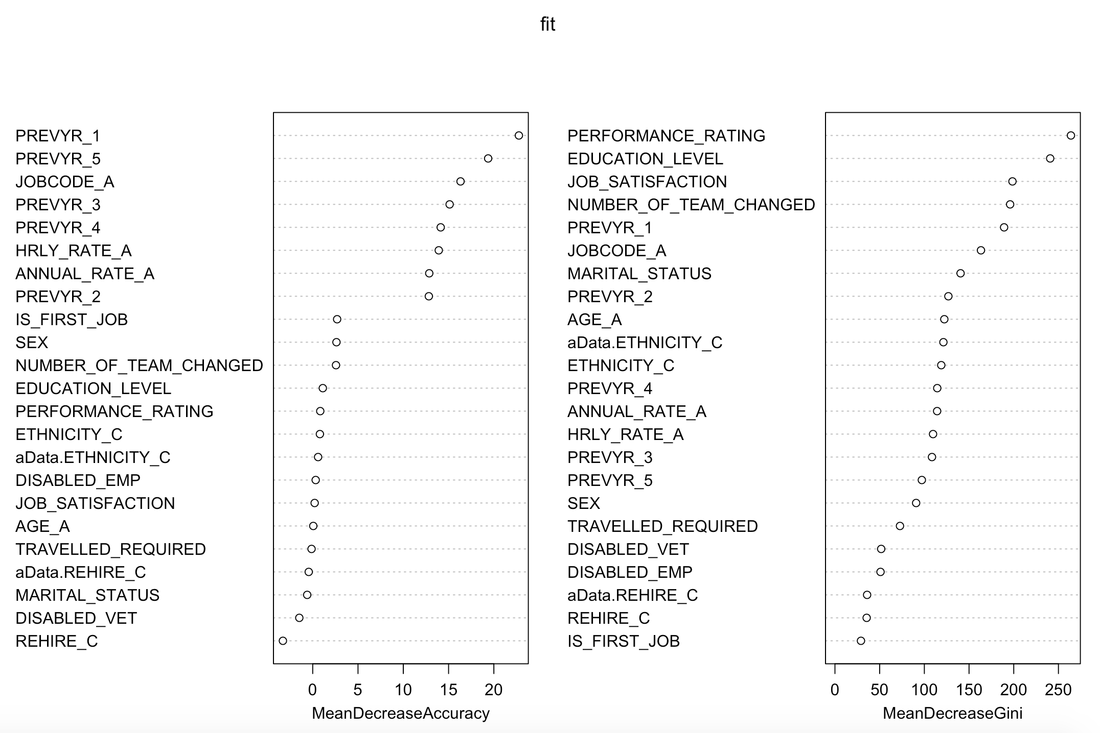
Random Forest
19
_____________________________

Slide 20
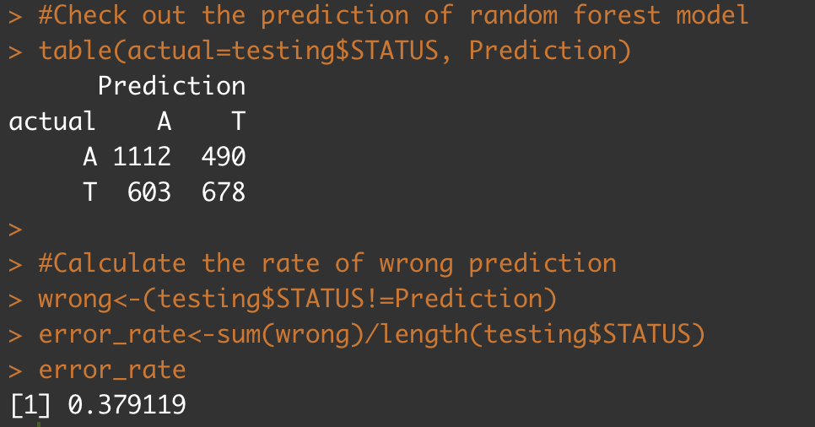
Random Forest(Cont.)
20
___________________________________

Slide 21
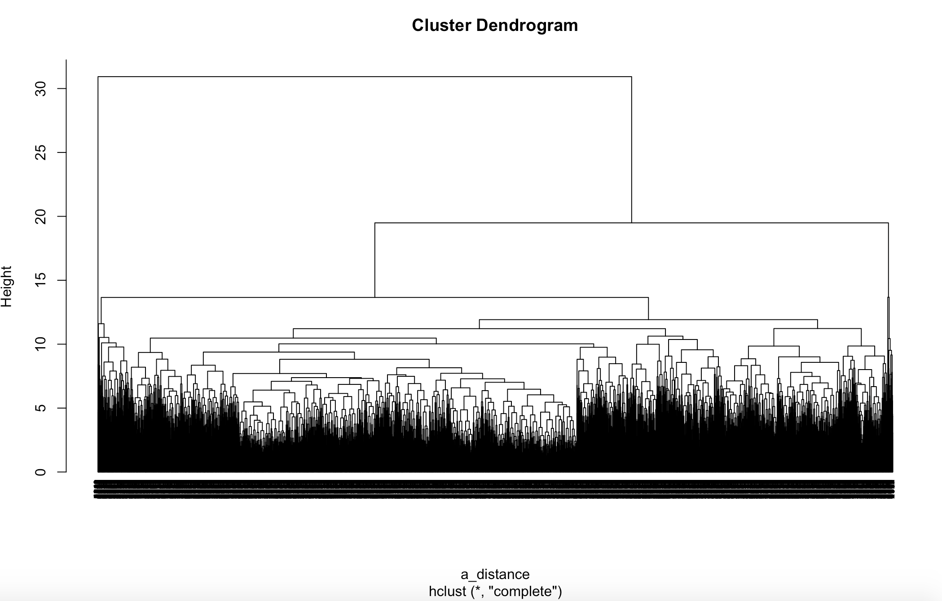
H Cluster
21
_____________________________
1

Slide 22
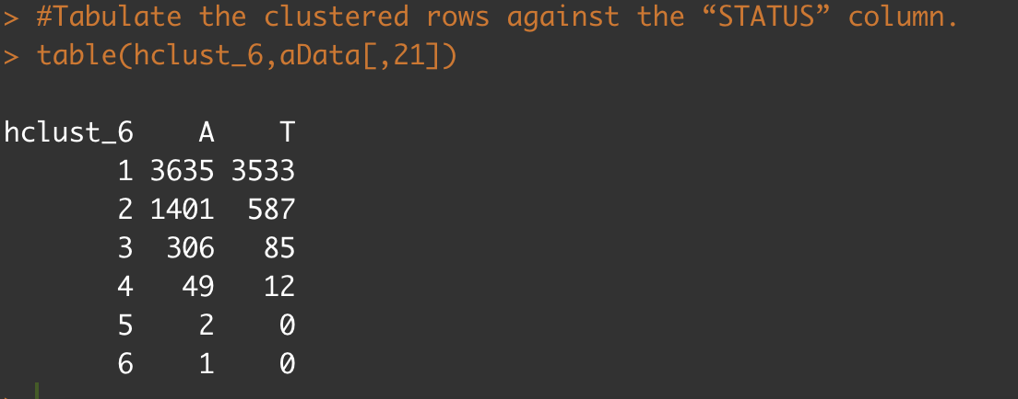
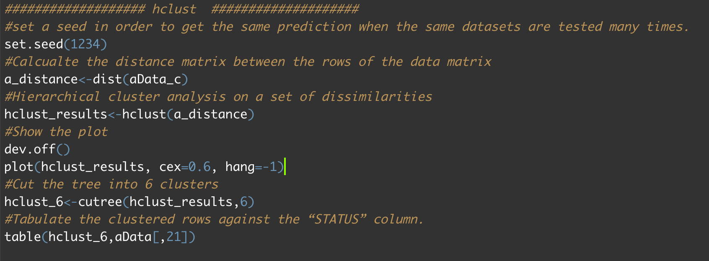
H Cluster Result
22
_____________________________
1

Slide 23
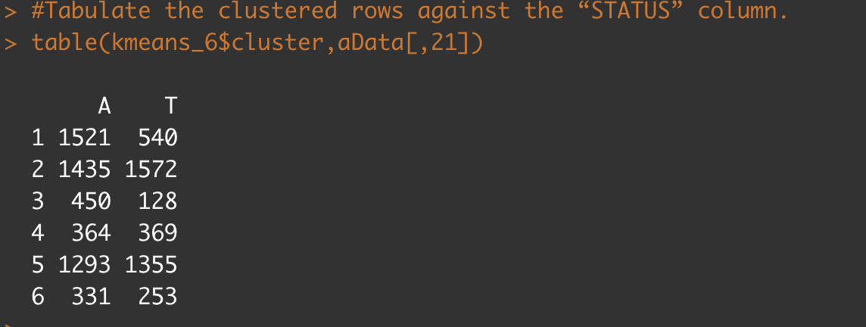
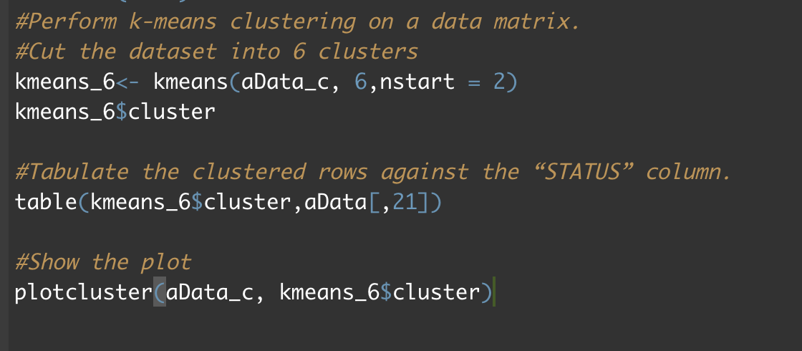
K-means
23
_____________________________

Slide 24
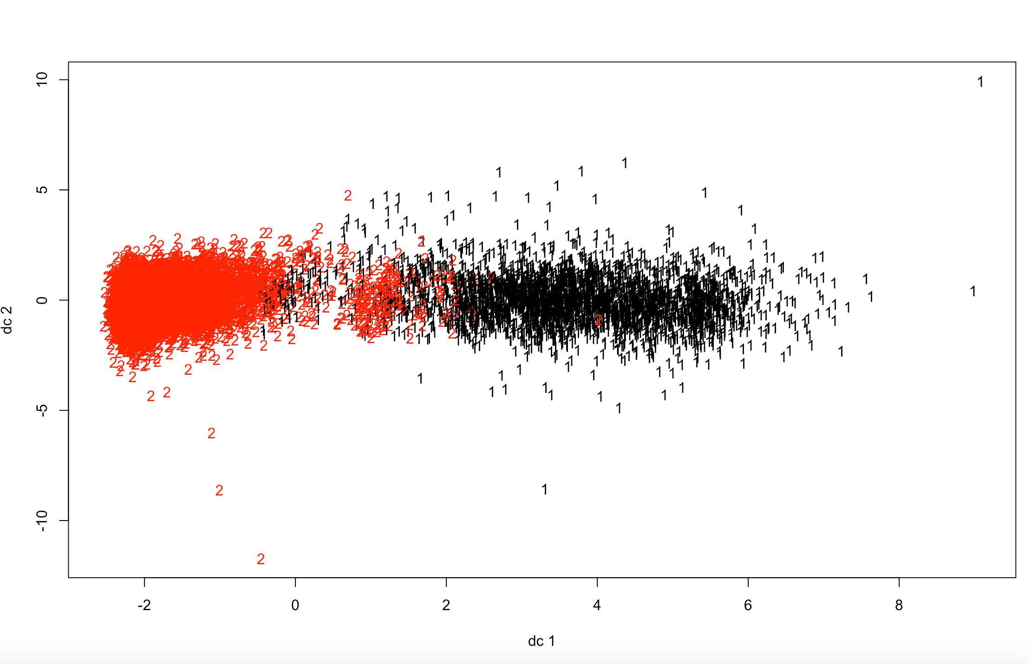
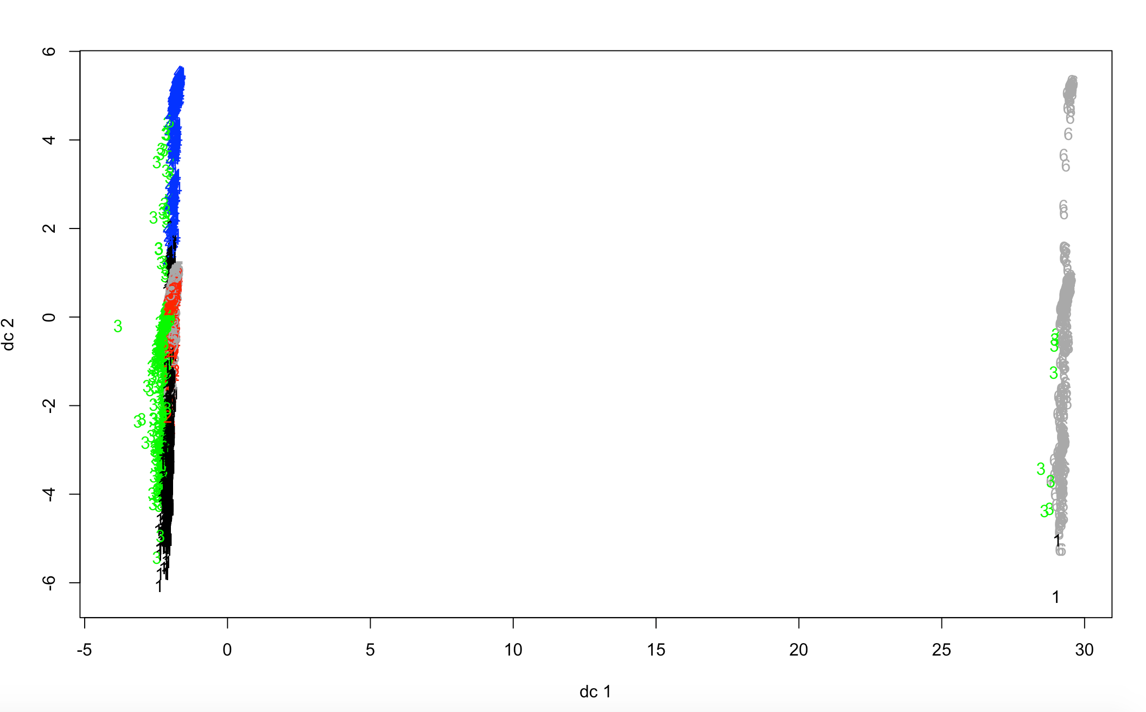
K-means(Cont.)
24
_____________________________
1

Slide 25
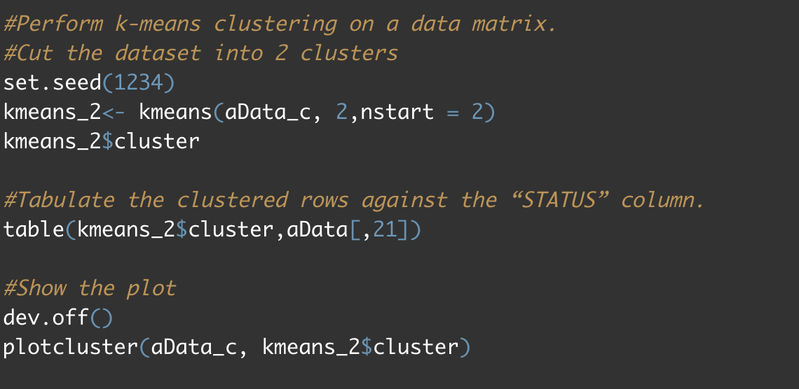
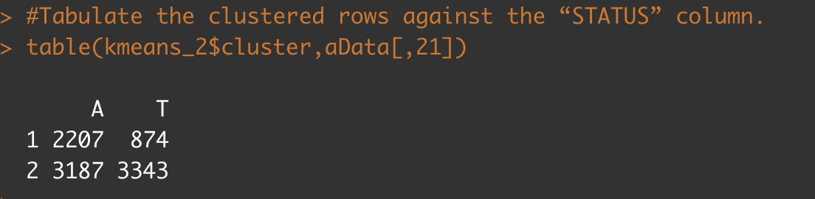
K-means(Cont.)
25
_____________________________

Slide 26
H-cluster & K-means conclusion
26
_____________________________
When we cut the datasets into 6 clusters, the cluster 1st 3rd 6th, more employee tend to stay at company; the clusters 2nd 4th 5th trend to leave the company. After checking the plot, we can simply set the two clusters up. So, the first cluster have a trend to stay at company; the others have a balance between leaving and staying.

Slide 27
27
Thank You

